Slide 1
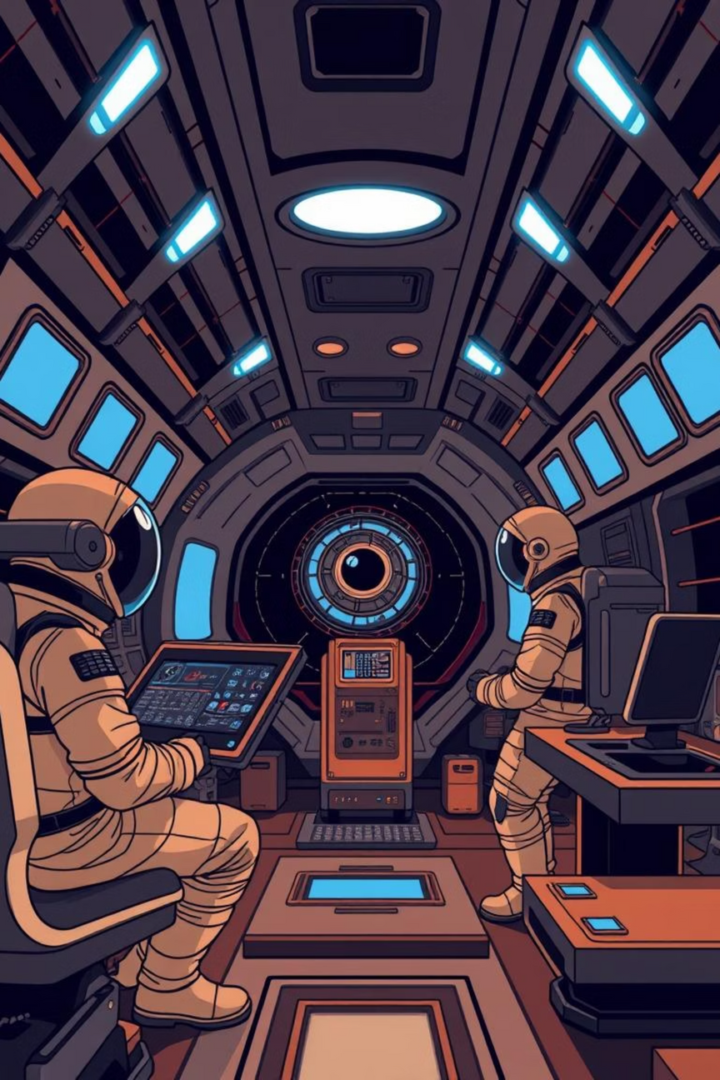
AI Safety System for Space Stations
Presented at the Hack With Hyderabad Hackathon 2025
Notes:
1

Slide 2





Project Overview
Project Name
Hackathon
AI Safety System for Space Stations
HackWithHyderabad Hackathon 2025
Team
Members
Nerds
Sreenikethan, Siddharth, Nandan, Sai Krishna
Notes:
2

Slide 3
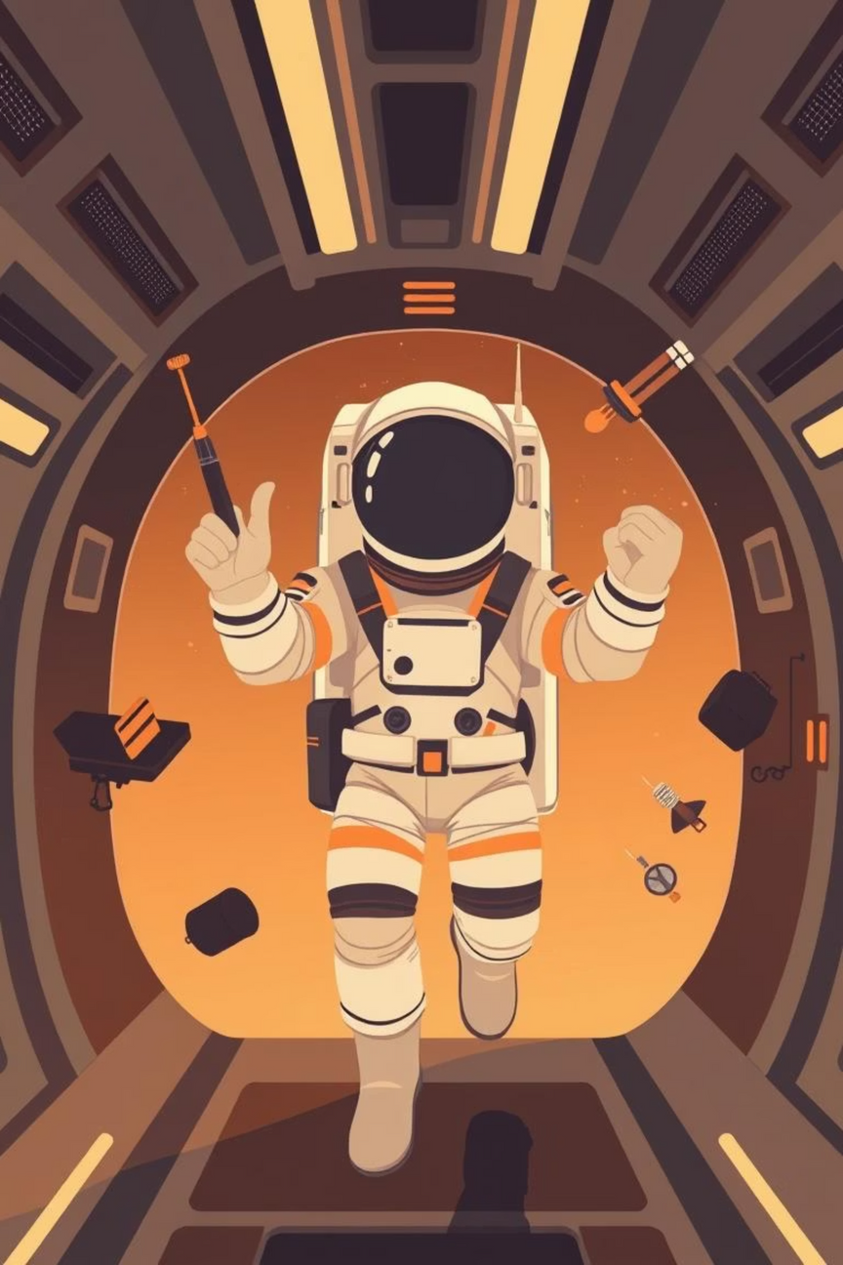
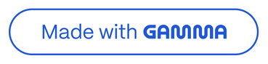
The Challenge: Astronaut Safety in Space
In the high-stakes environment of a space station, astronaut safety is paramount. Current manual inspection methods for tracking critical safety equipment and identifying potential hazards are prone to human error and are often inefficient.
Given the complex, zero-gravity environment, the risk of misplaced tools or floating debris is a constant threat. This challenge addresses the need for an automated, reliable system to monitor the station's interior and provide continuous surveillance to mitigate these risks.
Notes:
3

Slide 4
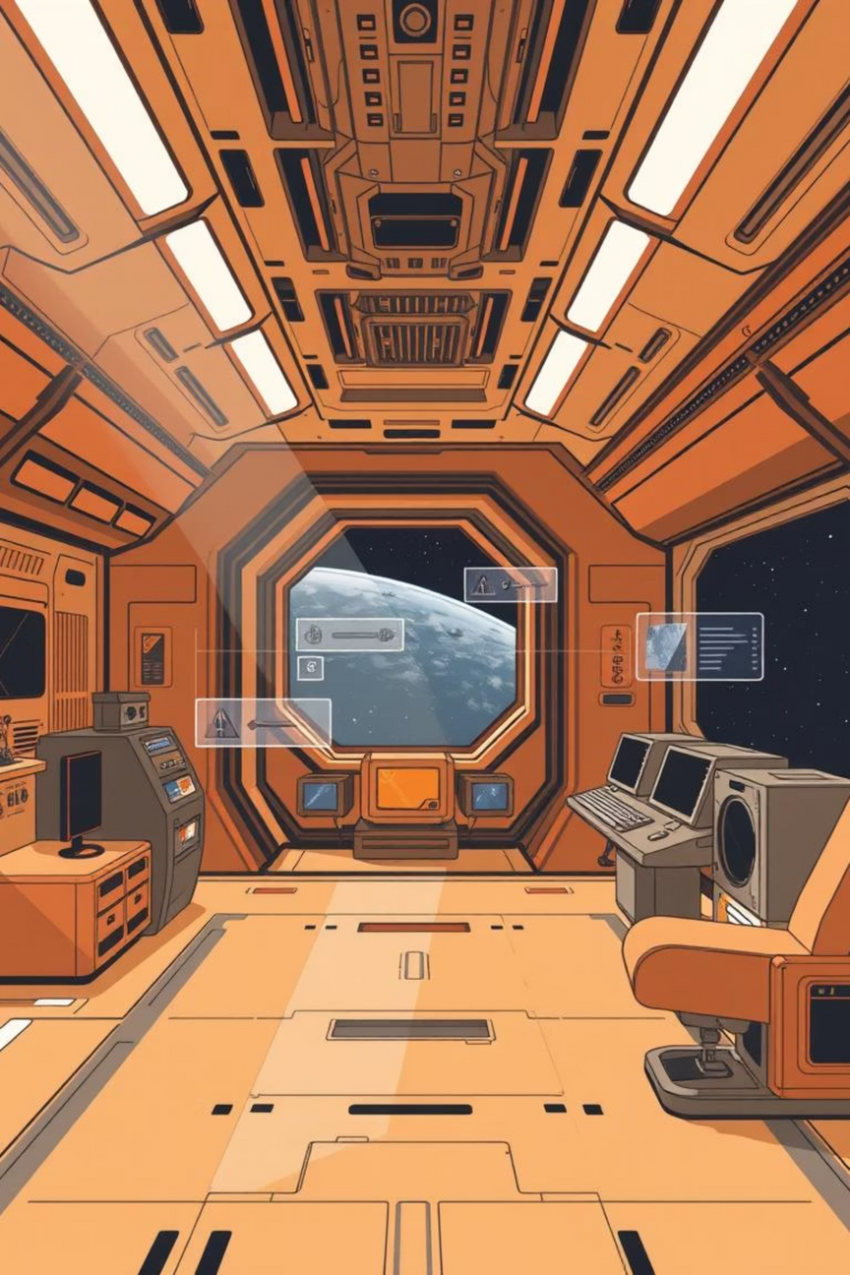



Our Solution: AI-Powered Monitoring
AI-Powered Monitoring
An AI-driven object detection system acts as a "digital safety officer" for the space station.
Real-time Detection
Utilizes onboard camera feeds for instant detection and classification of vital safety equipment.
Proactive Safety
Moves beyond manual checks to offer automated surveillance, enhancing crew safety and operational efficiency.
Notes:
4

Slide 5
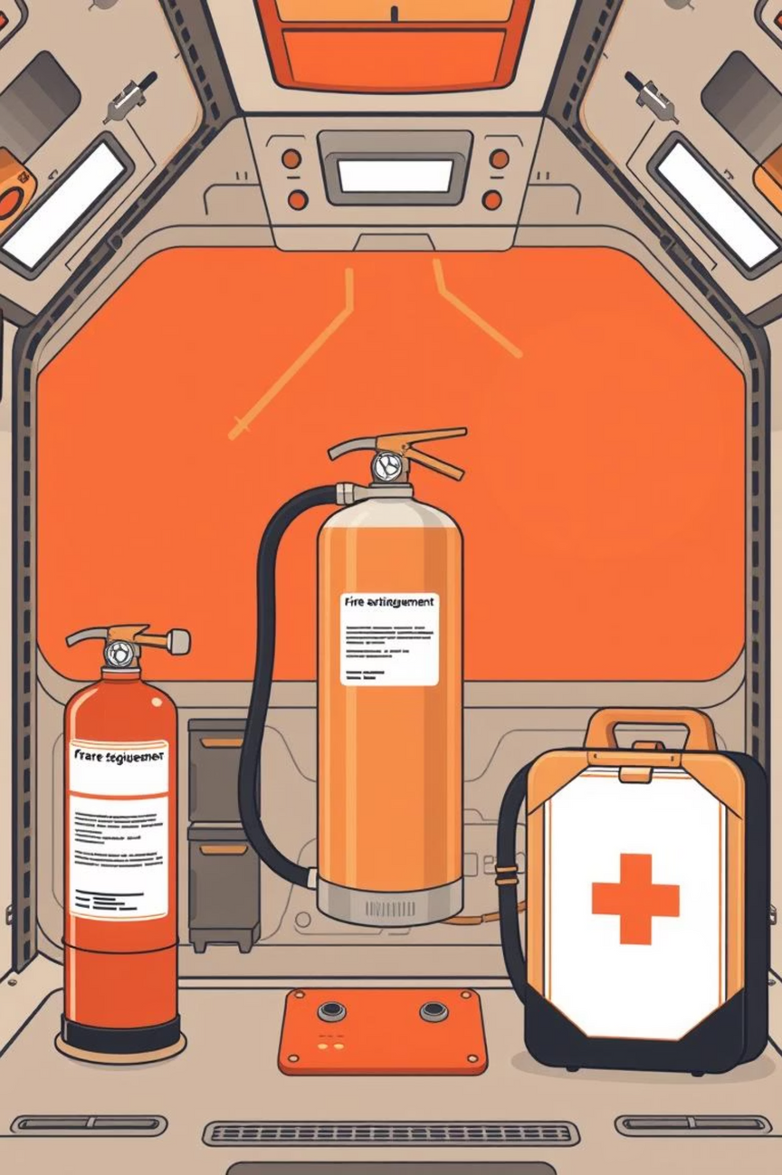
Key Applications of the AI Safety System
Astronaut Safety
Automatically detects misplaced tools or floating objects that could harm astronauts or damage equipment.
Maintenance
Monitors critical infrastructure like the SafetySwitchPanel for proper status and any signs of damage.
Inventory Management
Provides automated tracking of essential items such as OxygenTank, FireExtinguisher, and FirstAidBox.
Emergency Readiness
Instantly identifies the location of emergency gear and alarms, ensuring a rapid response in a crisis.
Notes:
5

Slide 6
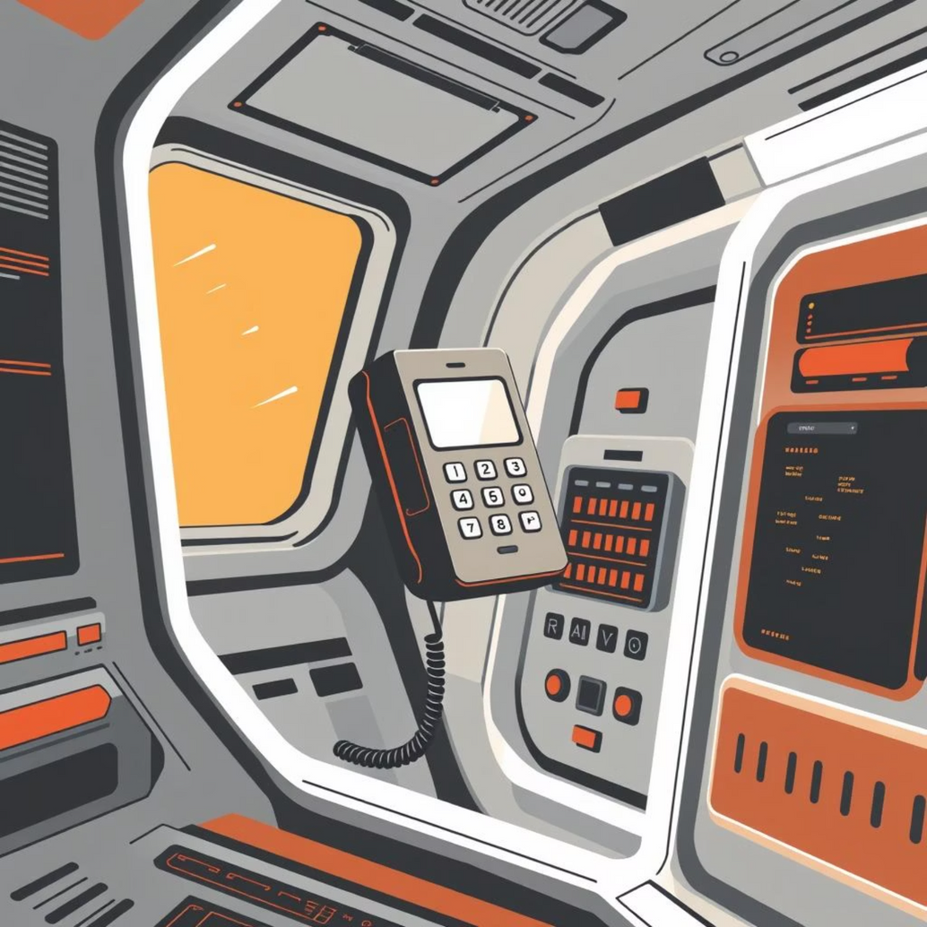
Use Case Scenario: Preventing a Floating Hazard
The Problem
An astronaut performing maintenance near a Safety Switch Panel accidentally detaches their Emergency Phone, which begins to float towards a critical system.
The System's Role
Onboard cameras immediately detect the object as an Emergency Phone.
The AI system classifies it and pinpoints its exact location and trajectory.
The Result
A real-time visual alert is sent to the astronaut’s display, showing the Emergency Phone’s position and identifying it as a floating hazard.
The system logs the event for inventory and future analysis, confirming the presence of all critical items.
This quick, automated intervention prevents potential damage and saves valuable time.
Notes:
6

Slide 7
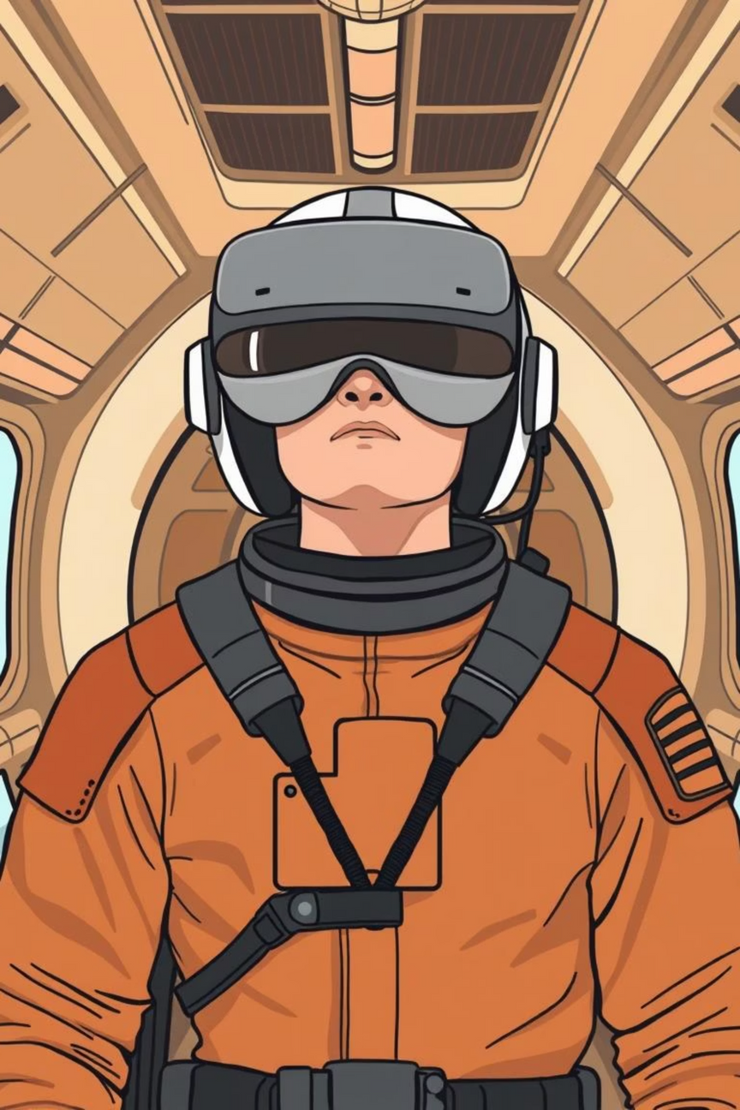




Key Benefits of Our AI Safety System
Reduces Human Error
Provides consistent, 24/7 monitoring, augmenting crew vigilance.
Improves Response Time
Automatically pinpoints emergency equipment location, saving critical seconds.
Enhances Operational Efficiency
Frees astronaut time from tedious manual checks for more critical tasks.
Scalable for Training
Model can be integrated into VR/AR systems for advanced astronaut training and simulation.
Notes:
7

Slide 8
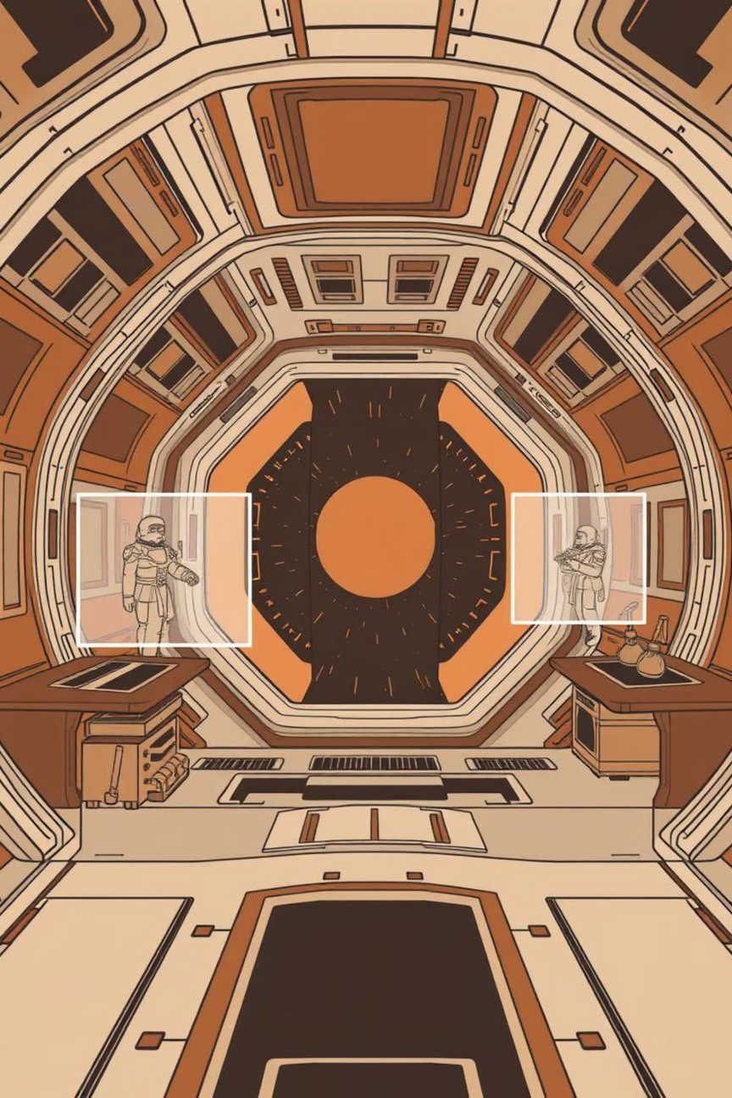
Technical Foundation
Core Technology
Built on the state-of-the-art YOLOv8 object detection framework.
Dataset
Trained on a high-quality synthetic dataset from Duality AI's Falcon digital twin platform.
Performance
Achieved a mAP > 85% with a < 15ms inference speed, exceeding hackathon benchmarks.
Deployment
Deployed as a web API on Hugging Face Spaces with a Gradio web UI for demonstration.
Notes:
8

Slide 9






Future Scope & Enhancements
Anomaly Detection
Expand the model to identify visual anomalies like leaks, rust, or loose wiring.
Robotic Arm Integration
Enable robotic systems to retrieve misplaced items based on model detections.
Ground Control Dashboard
Create a live dashboard for continuous safety status updates to ground control teams.
Notes:
9

Slide 10
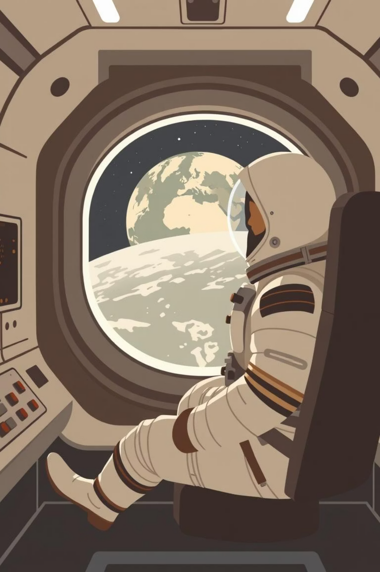
Conclusion: Protecting Lives with AI
Clear Value
Practical & Innovative
Our project delivers a clear and practical solution that directly enhances astronaut safety and mission success.
A scalable and efficient application of AI addressing a real-world, high-stakes problem.
Impact
Our model doesn’t just detect objects—it protects lives.
Notes:
10

